Slide 1
Correlation of Face Transplant Smile Excursion Measurements with Emotional Evaluation by Artificial Intelligence
Nathan Hebel, B.S.
Thanapoom Boonipat, M.D.
Jason Lin, M.D.
Samir Mardini, M.D.

Slide 2
Disclosures
The authors do not have any financial disclosures or commercial associations to disclose related to this presentation.

Slide 3
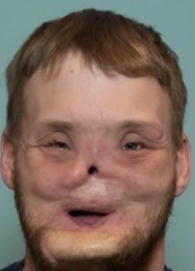
Introduction
What Do We Know?
History ¹
37 reported face transplants worldwide
Delayed motor innervation ¹
Rapid sensory recovery
Aesthetic outcomes poorly reported²
Subjective and limited to presence
Figure 1. Preoperative smile image (left) and neutral repose image at 66.7 months post-operation of the Mayo Clinic’s face transplant patient

Slide 4
Goal
Assess the feasibility of artificial intelligence in long term evaluation of face transplant progression

Slide 5
Methods
How Did We Do It?
Post-operative analysis at 6 month intervals for 66.7 months
FACEgram manual smile analysis
FaceReader artificial intelligence analysis
1. Internal comparison of techniques
2. External comparison to standard group

Slide 6
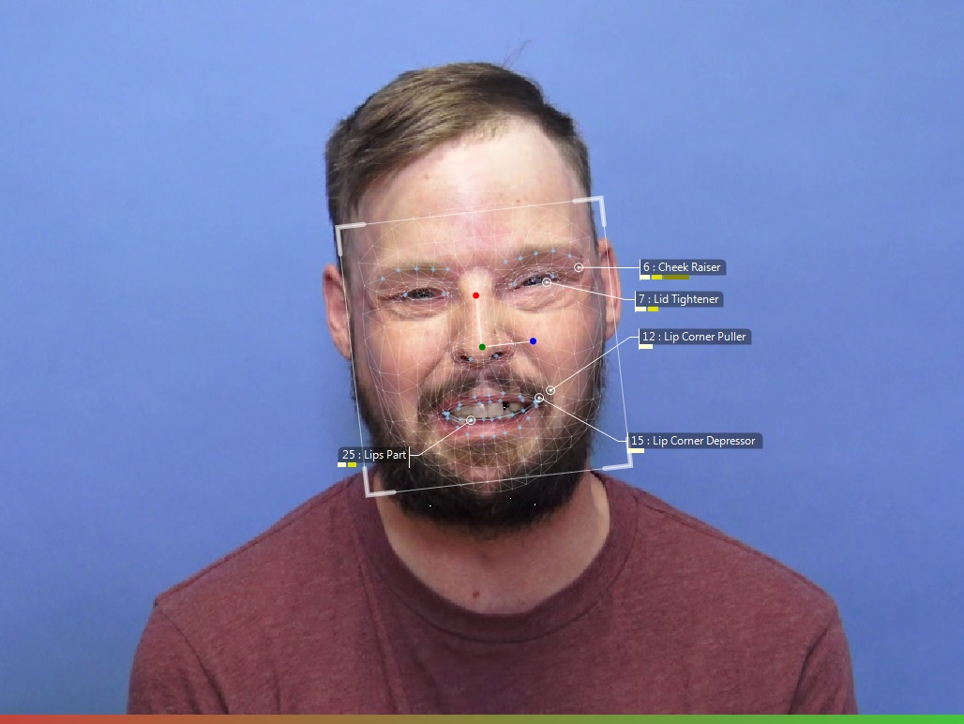
Methods
How Did We Do It?
FACEgram Analysis:
Smile excursion measurements
neutral repose and full face smile with teeth
Still images
Standardization of measurements via iris diameter
FaceReader Analysis:
Emotion and action unit analysis
Video clip examinations
Full face smile with teeth video clips
Figure 2. Representative FaceReader analysis still frame

Slide 7
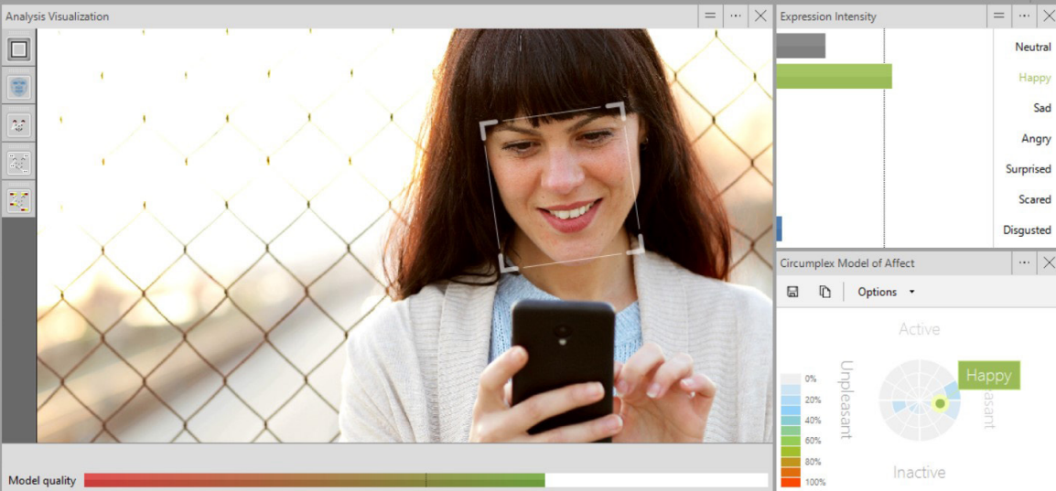
FaceReader
What is it?
Artificial neural network
Developed from over 20,000 hand annotated images by experts
Face modeling tracks 468 key facial landmarks
Outputs 8 cardinal emotions and 28 action units
Functions on images, video, and live footage
Figure 3. FaceReader developed exemplary images of analysis and outputted valence

Slide 8
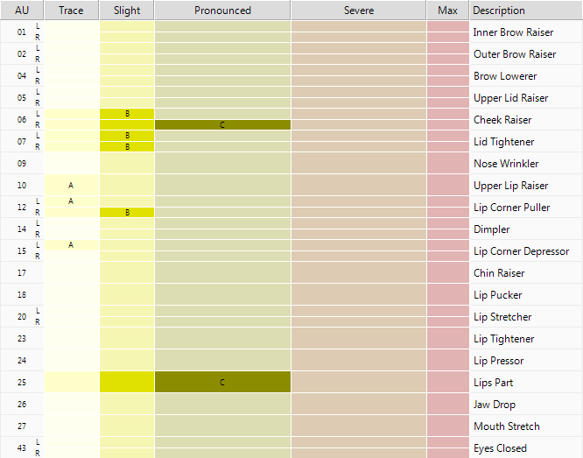
Results
What Did We Find?
Smile excursion increase from 3.58mm to 4.21mm (p=0.066)
Maximum value of 6.04mm
Standard group average of 6.23mm
Lip corner puller action unit increased from 0% to 60% at maximum (p=0.214), no detection in most recent follow up
Standard group average of 67.1%⁵
Cheek raiser action unit increased from 0% to 50% (p=0.0044)
Standard group average of 32.8%⁵
Figure 2. Representative FaceReader analysis of action unit function intensity

Slide 9
Emotion Results
What Did We Find?
Perceived happiness increased from 0% to 15.3% (p=0.0018)
Standard group average of 51.0%
Significant impact from unexamined facial action units
Holistic interpretation of emotion and action unit functioning
Figure 3. Representative FaceReader analysis of emotion

Slide 10
Candid Results
What Did We Find?
Analyzed candid photos of patient when they felt “happiest”
Highest happiness of 67.7%
Greatest lip corner puller action unit intensity of 80%
Demonstrates validity for analyzing self taken patient images and the impact of unanalyzed action units

Slide 11
Conclusion
What Do We Understand?
Surgical Success
Impact on Care
Both the AI and manual software discovered increased strength
AI reliably demonstrated the action units responsible for facial expression
Telemedicine implementation will reduce hospital and patient burden
Emotional expression in aesthetic surgery
Objective comparison of surgical techniques

Slide 12
References
Siemionow M. The decade of face transplant outcomes. J Mater Sci Mater Med. 2017 May;28(5):64. doi: 10.1007/s10856-017-5873-z. Epub 2017 Mar 16. PMID: 28303433.
Fischer S, Kueckelhaus M, Pauzenberger R, Bueno EM, Pomahac B. Functional outcomes of face transplantation. Am J Transplant. 2015 Jan;15(1):220-33. doi: 10.1111/ajt.12956. Epub 2014 Oct 30. PMID: 25359281.

Slide 13
Questions & Discussion

